Slide 1
恶意代码分析与防治技术 第9章 WinDBG内核调试
王志
zwang@nankai.edu.cn
南开大学 网络空间安全学院
2023/2024

Slide 2
知识点
系统内核与驱动
难点：设备（Device）、驱动（Driver）、物理设备（Physical Device）
WinDbg
Microsoft Symbols
内核调试实战
Rootkits
难点：SSDT、IDT

Slide 3
系统内核与驱动

Slide 4

主观题
10分
Windows内核会不会被计算机病毒感染？ 如果可以被感染，举例说明内核病毒有哪些行为。
作答

Slide 5
WinDbg vs. OllyDbg
What is the difference between WinDbg and OllyDbg?
Which type of malware we should use WinDbg for analysis?

Slide 6
WinDbg vs. OllyDbg
OllyDbg is the most popular user-mode debugger for malware analysts
Ghidra NSA
BinaryNinja
WinDbg can be used in either user-mode or kernel-mode
This chapter explores ways to use WinDbg for kernel debugging and rootkit analysis

Slide 7
投票
最多可选1项
Windows内核中的代码是不是全是微软公司开发的？
A
是
B
不是
提交

Slide 8
驱动（Drivers）
驱动是一个软件组件（Software Component），实现操作系统与设备之间的通信。
应用程序通过Windows API访问设备
Windows将访问请求转发给驱动程序，调用驱动程序提供的功能函数
驱动程序由设备制造商开发，完成对设备硬件的访问。

Slide 9
单选题
10分
是不是所有的驱动都是由设备制造商提供的？
A
是
B
不是
提交

Slide 10
驱动栈（Driver Stack）
并不是所有的驱动都直接与设备进行通信
一次设备的访问过程通常会经过多个驱动
驱动栈（Driver Stack）
过滤驱动（Filter Driver）
杀毒软件、防火墙、入侵检测等
功能驱动（Function Driver）
一个设备栈最多只有一个功能驱动

Slide 11
单选题
10分
驱动栈中，过滤驱动一定在功能驱动的上面？
A
正确
B
错误
提交

Slide 12
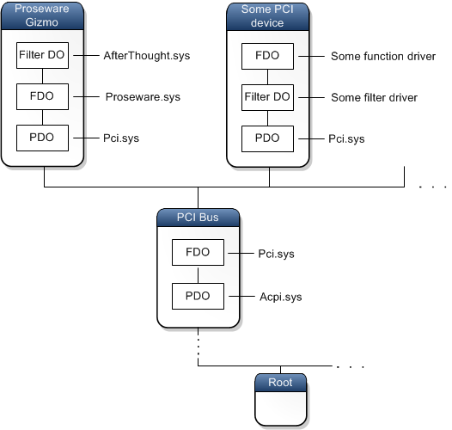
过滤驱动
上层过滤驱动（Upper Filter Driver）
在功能驱动之前的过滤驱动
下层过滤驱动（Lower Filter Driver）
在功能驱动之后的过滤驱动
https://learn.microsoft.com/en-us/windows-hardware/drivers/gettingstarted/device-nodes-and-device-stacks

Slide 13
单选题
10分
应用程序可以直接访问驱动程序吗？
A
可以
B
不可以
提交

Slide 14
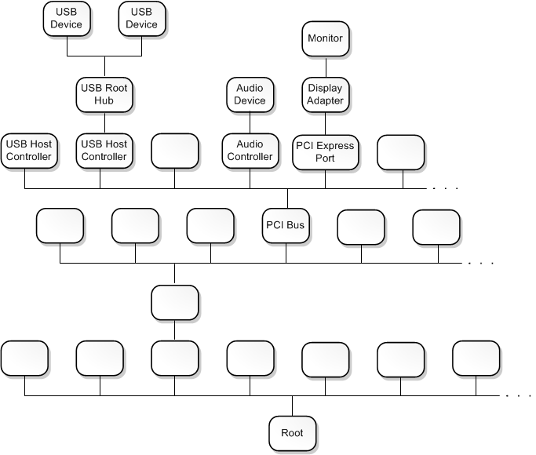
设备树
Windows使用即插即用管理器(Plug and Play Manager)，创建设备树(Device Tree)，来管理系统中的设备
设备节点（Device Node）
不是所有的设备节点都对应物理设备
软件组件
根设备节点（Root Device Node）
根节点在树的最下面
继承关系(Parent/Child Relationships)
PCI总线-->USB Host Controller-->USB Root Hub -->USB Device
https://learn.microsoft.com/en-us/windows-hardware/drivers/gettingstarted/device-nodes-and-device-stacks

Slide 15
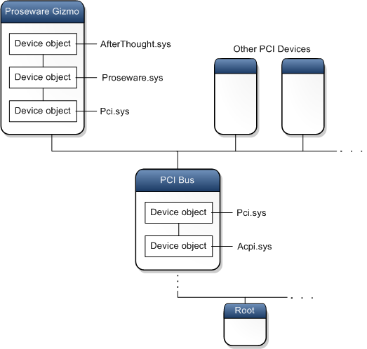
设备栈
每个设备节点是一个有序的设备对象列表
每个设备对象关联一个驱动
<设备对象、驱动>
Proseware Gizmo设备栈中有3个设备对象
PCI Bus设备栈有2个设备对象
https://learn.microsoft.com/en-us/windows-hardware/drivers/gettingstarted/device-nodes-and-device-stacks

Slide 16
设备对象（Device Objects）
PnP管理器控制总线驱动枚举挂在其上的设备
发现的设备创建物理设备对象（Physical Device Object, PDO）
遍历注册表，找到PDO对应的驱动，创建设备栈
PDO始终是设备栈的底部设备对象
https://learn.microsoft.com/zh-cn/windows-hardware/drivers/kernel/introduction-to-device-objects

Slide 17
USB Flash Drive
User plugs in flash drive
Windows creates the "F: drive" device object
Applications can now make requests to the F: drive
They will be sent to the driver for USB flash drives

Slide 18
多选题
10分
下面那个选项可以被用户空间的应用程序直接访问？
A
物理设备 physical hardware
B
设备驱动 device driver
C
设备对象 device object
D
Windows 内核
提交

Slide 19
Loading Drivers
Drivers must be loaded into the kernel
Just as DLLs are loaded into processes
When a driver is first loaded, its DriverEntry procedure is called
Just like DLLMain for DLLs

Slide 20
DriverEntry
DLLs expose functionality through the export table
Drivers must register the address for callback functions

Slide 21
DriverEntry
They will be called when a user-space software component requests a service
DriverEntry performs this registration
Windows creates a driver object structure, passes it to DriverEntry which fills it with callback functions
DriverEntry then creates a device object that can be accessed from user-land

Slide 22
Example: Normal Read
Normal read request
User-mode application obtains a file handle to device
Calls ReadFile on that handle
Kernel processes ReadFile request
Invokes the driver's callback function handling I/O

Slide 23
Malicious Request
Most common request from malware is DeviceIoControl
A generic request from a user-space module to a device managed by a driver
User-space program passes in an arbitrary-length buffer of input data
Received an arbitrary-length buffer of data as output

Slide 24
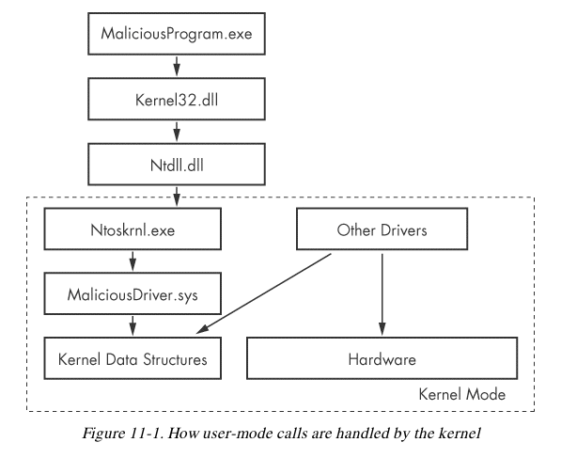
Ntoskrnl.exe & Hal.dll
Malicious drivers rarely control hardware
They interact with Ntoskrnl.exe & Hal.dll
Ntoskrnl.exe has code for core OS functions
Hal.dll has code for interacting with main hardware components
Malware will import functions from one or both of these files so it can manipulate the kernel

Slide 25
多选题
10分
Which are supported by WinDbg?
A
user-mode debugging
B
kernel-mode debugging
C
rootkit debugging
D
application debugging
提交

Slide 26
多选题
10分
Which statements are true for driver?
A
creates and destroys device objects
B
loaded into kernel
C
can be accessed from user space
D
has a DriverEntry procedure
提交

Slide 27
多选题
10分
Which statements are true for DriverEntry？
A
a procedure in driver
B
registers callback functions
C
creates device
D
initializes driver object structure
提交

Slide 28
多选题
10分
Which items are usually manipulated by malicious drivers?
A
kernel32.dll
B
hardware
C
ntoskrnl.exe
D
hal.dll
提交

Slide 29
WinDGB

Slide 30
VMware
In the virtual machine, enable kernel debugging
Configure a virtual serial port between VM and host
Configure WinDbg on the host machine

Slide 31
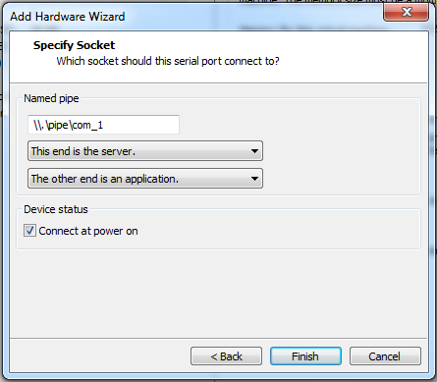
Add a Virtual Serial Port

Slide 32
Reading from Memory
dx addressToRead
x can be
da Displays as ASCII text
du Displays as Unicode text
dd Displays as 32-bit double words
da 0x401020
Shows the ASCII text starting at 0x401020

Slide 33
Editing Memory
ex addressToWrite dataToWrite
x can be
ea Writes as ASCII text
eu Writes as Unicode text
ed Writes as 32-bit double words

Slide 34
Using Arithmetic Operators
Usual arithmetic operators + - * /
dwo reveals the value at a 32-bit location pointer
dereference，dword from specified address
du dwo (esp+4)
Shows the first argument for a function, as a wide character string

Slide 35
Setting Breakpoints
bp sets breakpoints
You can specify an action to be performed when the breakpoint is hit
g tells it to resume running after the action
bp GetProcAddress "da dwo(esp+8); g"
Breaks when GetProcAddress is called, prints out the second argument, and then continues
The second argument is the function name

Slide 36
Listing Modules
lm
Lists all modules loaded into a process
Including EXEs and DLLs in user space
And the kernel drivers in kernel mode
As close as WinDbg gets to a memory map

Slide 37
单选题
10分
How to read a Unicode string starting at 0x00402000
A
da 0x00402000
B
du 0x00402000
C
ea 0x00402000
D
eu 0x00402000
提交

Slide 38
单选题
10分
Which command could write a ASCII string into memory?
A
da
B
ea
C
du
D
lm
提交

Slide 39
单选题
10分
How to set a breakpoint at LoadLibrary?
A
bp LoadLibrary
B
ex LoadLibrary
C
lm LoadLibrary
D
da LoadLibray
提交

Slide 40
单选题
10分
Which command could continue execution after breakpoint?
A
g
B
bp
C
da
D
eu
提交

Slide 41
Microsoft Symbols

Slide 42
Symbols are Labels
Including symbols lets you use
MmCreateProcessAddressSpace
instead of
0x8050f1a2

Slide 43
Searching for Symbols
moduleName!symbolName
Can be used anywhere an address is expected
moduleName
The EXE, DLL, or SYS filename (without extension)
symbolName
Name associated with the address
ntoskrnl.exe is an exception, and is named nt
Ex: u nt!NtCreateProcess
Unassembles that function (disassembly)

Slide 44
Deferred Breakpoints
bu newModule!exportedFunction
设置未解析断点
Will set a breakpoint on exportedFunction as soon as a module named newModule is loaded
$iment
Function that finds the entry point of a module
bu $iment(driverName)
Breaks on the entry point of the driver before any of the driver's code runs

Slide 45
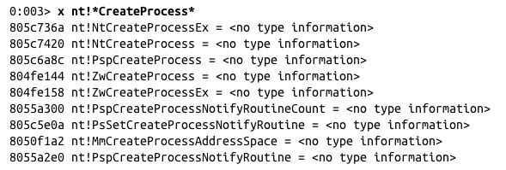
Searching with x
You can search for functions or symbols using wildcards
x nt!*CreateProcess*
Displays exported functions & internal functions

Slide 46
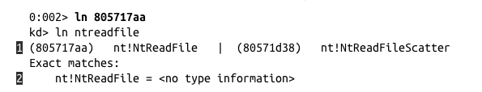
Listing Closest Symbol with ln
Helps in figuring out where a call goes
ln address
First lines show two closest matches
Last line shows exact match

Slide 47
Viewing Structure Information with dt
Microsoft symbols include type information for many structures
Including undocumented internal types
They are often used by malware
dt moduleName!symbolName
dt moduleName!symbolName address
Shows structure with data from address

Slide 48
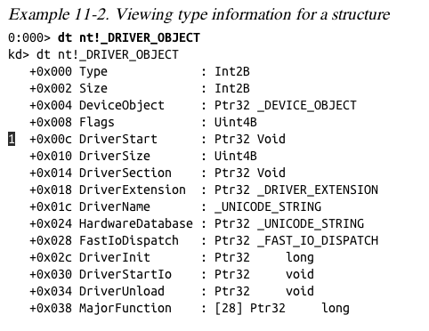

Slide 49
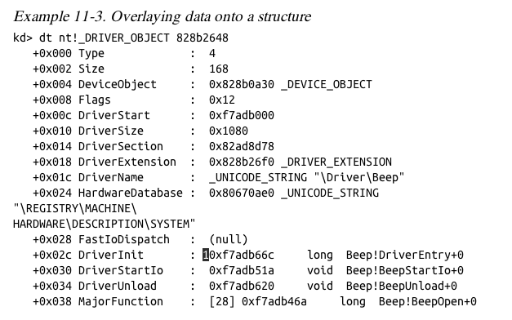

Slide 50
Initialization Function
The DriverInit function is called first when a driver is loaded
Malware will sometimes place its entire malicious payload in this function

Slide 51
Configuring Windows Symbols
If your debugging machine is connected to an always-on broadband link, you can configure WinDbg to automatically download symbols from Microsoft as needed
They are cached locally
File, Symbol File Path
SRC*c:\websymbols*http://msdl.microsoft.com/download/symbols

Slide 52
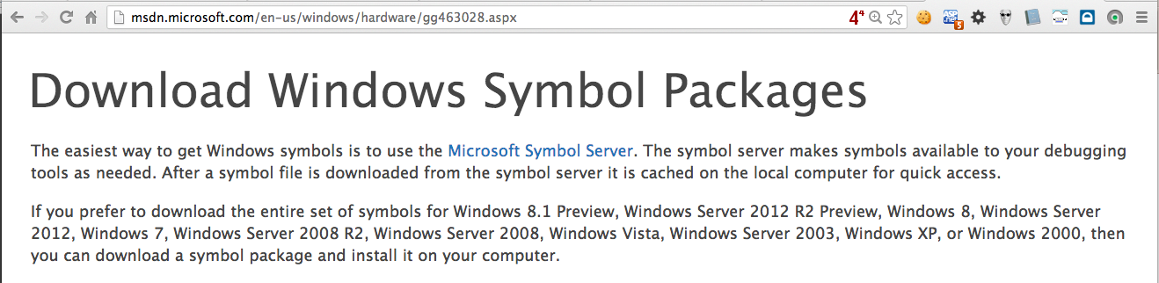
Manually Downloading Symbols

Slide 53
单选题
10分
Which module’s name is nt in WinDbg?
A
kernel32.dll
B
ntoskrnl.exe
C
hal.dll
D
ntdll.dll
提交

Slide 54
单选题
10分
How to list closest symbol at a specified address?
A
ln
B
lm
C
du
D
dt
提交

Slide 55
单选题
10分
How to view a structure information at a specified memory address?
A
dt
B
da
C
du
D
dd
提交

Slide 56
单选题
10分
Which function is called first when a driver is loaded?
A
DriverInit
B
DriverEntry
C
DllMain
D
WinMain
提交

Slide 57
内核调试实战

Slide 58
Kernel Mode and User Mode Functions
We'll examine a program that writes to files from kernel space
Kernel mode programs cannot call user-mode functions like CreateFile and WriteFile
Must use NtCreateFile and NtWriteFile

Slide 59
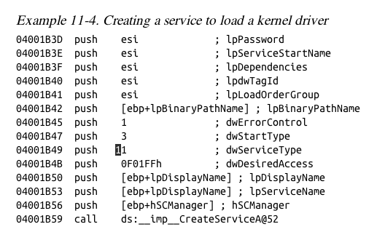
User-Space Code
Creates a service with the CreateService function
dwServiceType is 0x01 (Kernel driver)

Slide 60
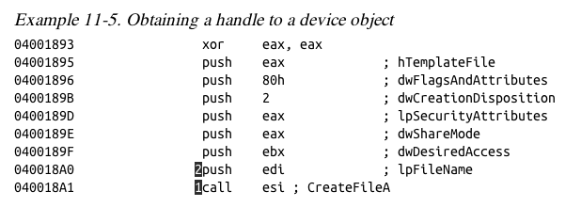
User-Space Code
Not shown: edi being set to
\\.\FileWriter\Device

Slide 61
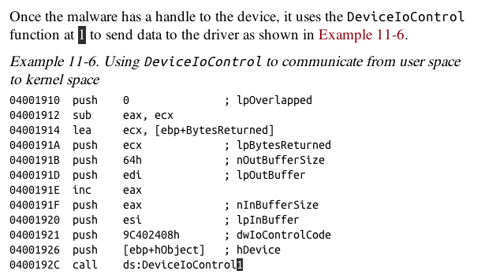
User-Space Code

Slide 62

Kernel-Mode Code
Set kernel-mode debugger to Verbose mode
You'll see every kernel module that loads
Kernel modules are not loaded or unloaded often
Any loads are suspicious
Except Kmixer.sys in VMware machines

Slide 63
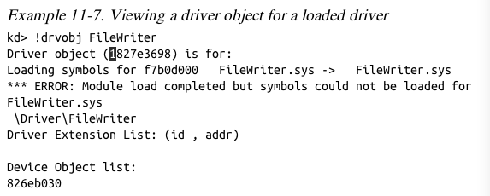
Kernel-Mode Code
!drvobj command shows driver object

Slide 64
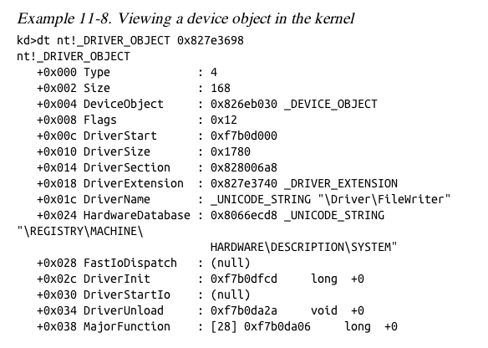
Kernel-Mode Code
dt command shows structure

Slide 65
Kernel-Mode Filenames
Tracing this function, it eventually creates this file
\DosDevices\C:\secretfile.txt
This is a fully qualified object name
Identifies the root device, usually \DosDevices

Slide 66
Finding Driver Objects
Applications work with devices, not drivers
Look at user-space application to identify the interesting device object
Use device object in User Mode to find driver object in Kernel Mode
Use !devobj to find out more about the driver object
Use !devhandles to find application that use the driver

Slide 67
填空题
10分
Kernel mode programs [填空1] (can or cannot) call user-mode functions
正常使用填空题需3.0以上版本雨课堂
作答

Slide 68
Rootkits

Slide 69
Rootkit Basics
Rootkits modify the internal functionality of the OS to conceal themselves
Hide processes, network connections, and other resources from running programs
Difficult for antivirus, administrators, and security analysts to discover their malicious activity

Slide 70
Rootkit Basics
Most rootkits modify the OS kernel
Most popular method:
System Service Descriptor Table (SSDT) hooking

Slide 71
System Service Descriptor Table (SSDT)
Used internally by Microsoft
To look up function calls into the kernel
Not normally used by third-party applications or drivers

Slide 72
SSDT
Only three ways for user space to access kernel code
SYSCALL
SYSENTER
INT 0x2E

Slide 73
SYSENTER
Used by modern versions of Windows
Function code stored in EAX register

Slide 74
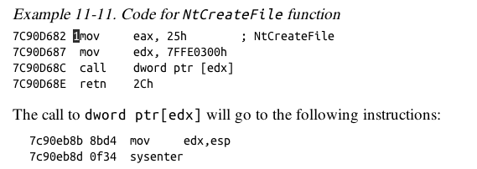
Example from ntdll.dll
EAX set to 0x25
Stack pointer saved in EDX
SYSENTER is called

Slide 75
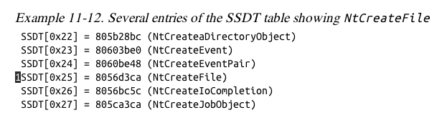
SSDT Table Entries
Rootkit changes the values in the SSDT so rootkit code is called instead of the intended function
0x25 would be changed to a malicious driver's function
Hooking NtCreateFile

Slide 76
Rootkit Analysis in Practice
Simplest way to detect SSDT hooking
Just look at the SSDT
Look for values that are unreasonable
In this case, ntoskrnl.exe starts at address 804d7000 and ends at 806cd580
ntoskrnl.exe is the Kernel!

Slide 77
Rootkit Analysis in Practice
lm m nt
Lists modules matching "nt" (Kernel modules)
Shows the SSDT table

Slide 78
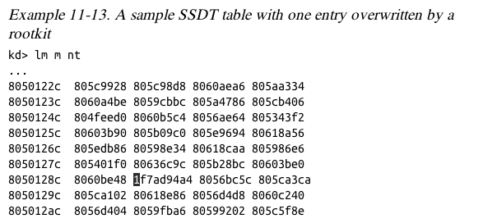
SSDT Table
Marked entry is hooked
To identify it, examine a clean system's SSDT

Slide 79
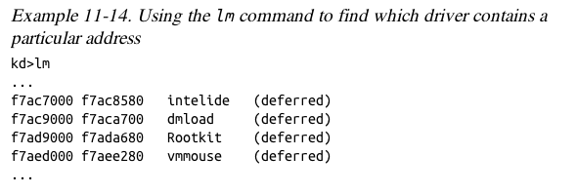
Finding the Malicious Driver
lm
Lists open modules
In the kernel, they are all drivers

Slide 80
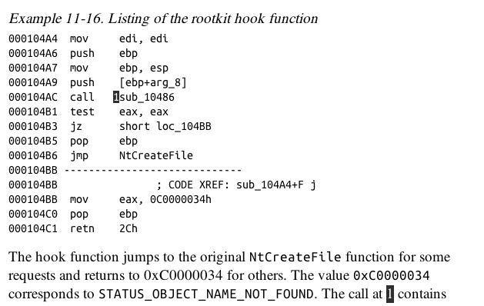

Slide 81
Interrupts
Interrupts allow hardware to trigger software events
Driver calls IoConnectInterrupt to register a handler for an interrupt code
Specifies an Interrupt Service Routine (ISR)
Will be called when the interrupt code is generated
Interrupt Descriptor Table (IDT)
Stores the ISR information
!idt command shows the IDT

Slide 82
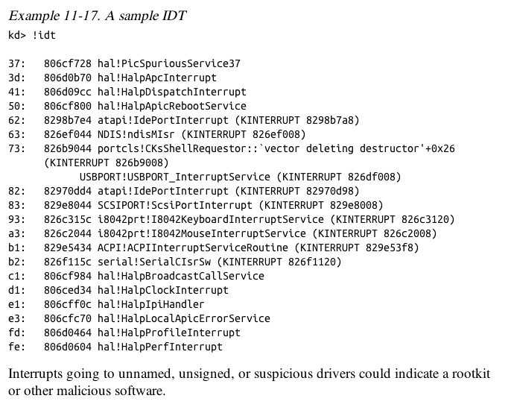

Slide 83
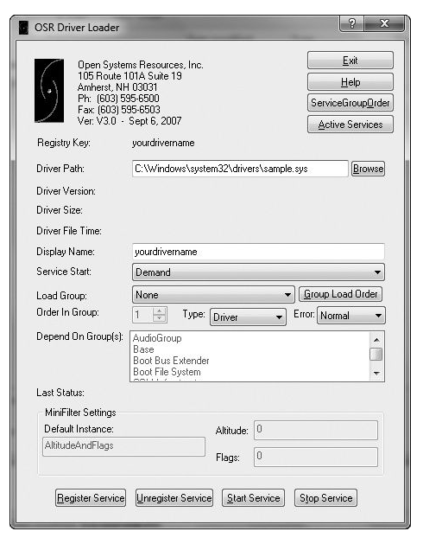
Loading Drivers
If you want to load a driver to test it, you can download the OSR Driver Loader tool

Slide 84
Driver Signing
Enforced in all 64-bit versions of Windows starting with Vista
Only digitally signed drivers will load
Effective protection!
Kernel malware for x64 systems is practically nonexistent
You can disable driver signing enforcement by specifying nointegritychecks in BCDEdit

Slide 85
恶意代码分析与防治技术 第9章 WinDBG内核调试
王志
zwang@nankai.edu.cn
南开大学 网络空间安全学院
2023/2024

Slide 86
知识点
系统内核与驱动
难点：设备（Device）、驱动（Driver）、物理设备（Physical Device）
WinDbg
Microsoft Symbols
内核调试实战
Rootkits
难点：SSDT、IDT

